Slide 1

DATA ANALYTICS PORTFOLIO
Jourdan Mason

Slide 2


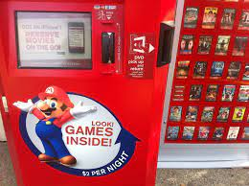

Projects
GameCO
Analyzed global sales of video games on all platforms using Excel pivot tables to inform the development of new games.
CDC Influenza
Prepare for the upcoming Influenza season by cleaning and integrating government data in Excel. Using Tableau for visualizations and to better understand what area and age group need the most help.
Rockbuster
Stealth
Using PostgresSQL to analyze data and answer questions about customer’s spending and rental habits.
Instacart
Analyzed data to find customer preferences and sales patterns by using Python 3 to clean, integrate, and visualize data provided by Instacart.

Slide 3

GAMECO
Project Goals
Analysis sales history and marketing Shares from 1980s.
Find the best-selling genre and platform
Data
Platform Totals – VGChartz
Data contains historical video game sales in 3 main regions from years 1986 to 2016
Tools
Excel
Skills
Pivot tables
Data integrity, quality, and accuracy
Cleaning, grouping, and summarizing data
Conduct statistical analysis
Visualize and present insights

Slide 4
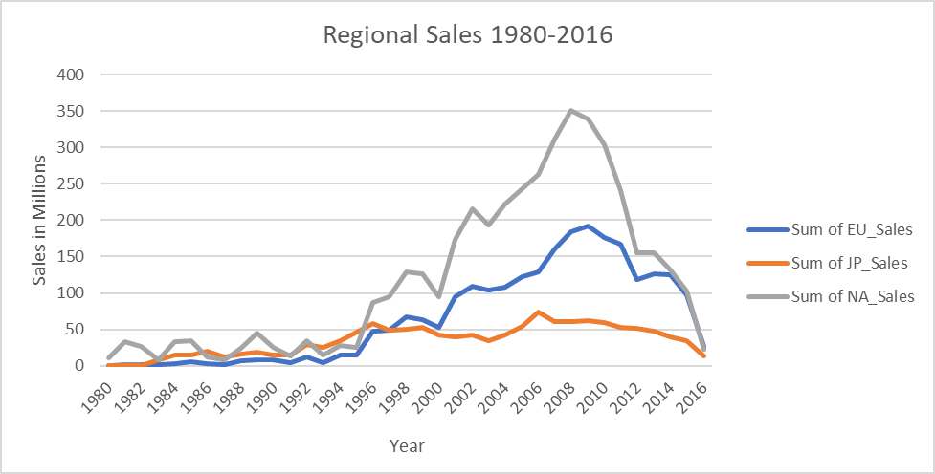
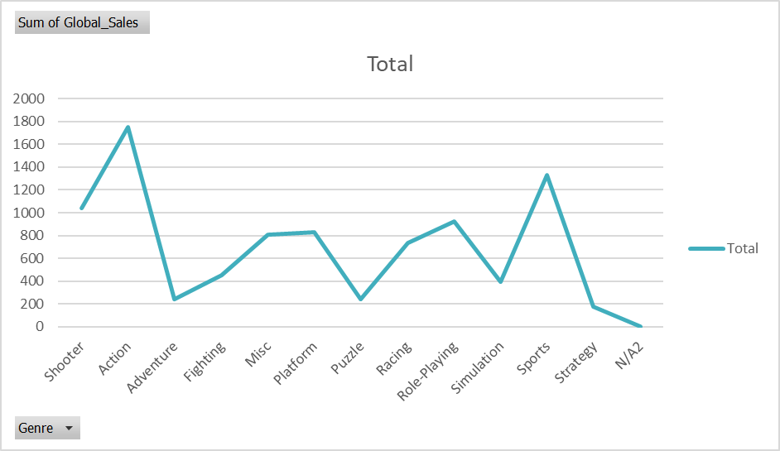
Analysis of sales trends in different geographies. Identifying patterns in data Drawing conclusions based on the trends and their behavior over time
SALES TREND ANALYSIS

Slide 5
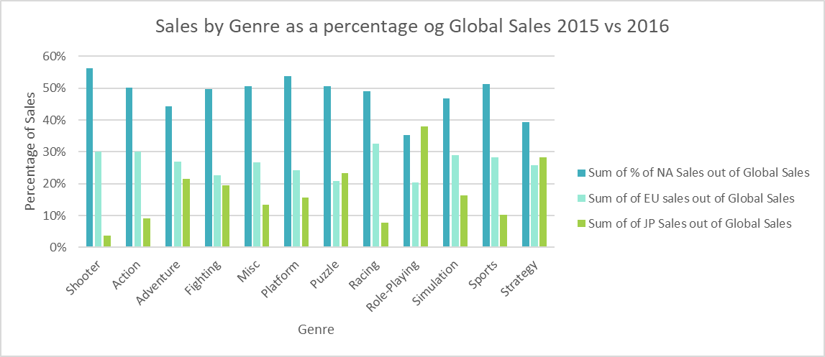
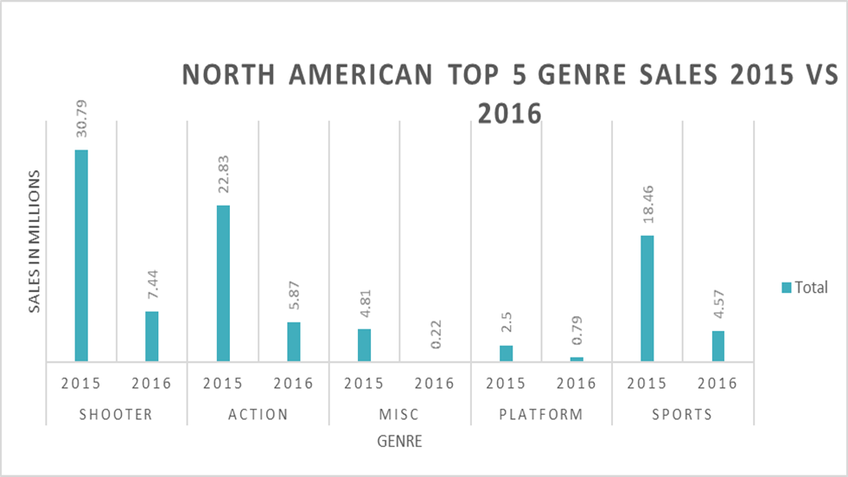
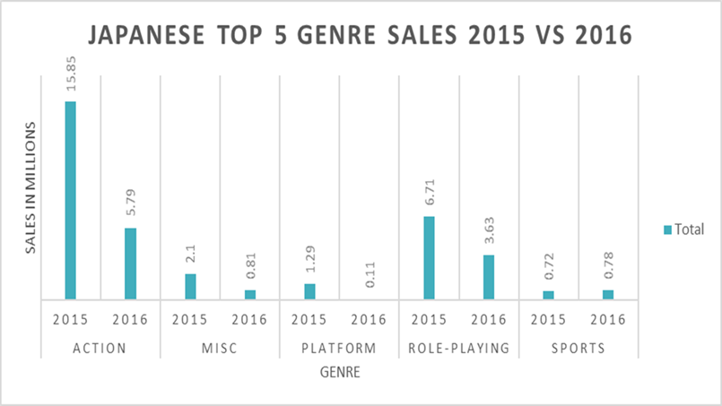
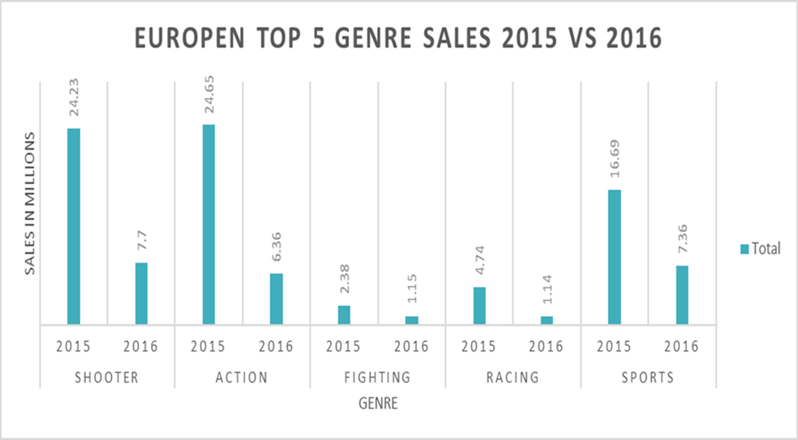
COMPARING VIDEO GAME GENRES ACROSS REGION
Used pivot tables to cross assess the most popular items Used MS Excel to manipulate data
Created different types of visualizations to underscore important point

Slide 6
Project Results and Recommendations
Results
Recommendations
North America has had the largest sales globally, being at or above 50% of Global Sales until 2016 when Europe surpassed, with 38% of Global Sales and North America at 32% of Global Sales.
North America has a larger population and could be why they were the top selling region for the longest time, Japan has a smaller population and can play a role into why their sales are so much lower, and Europe is the only region who has had a steady increase in Global Sales.
North America has dropped the most being at 52% in 2008 and 32% in 2016. Europe was at 27% in 2008 and 38% in 2016. Japan was at 9% in 2008 and 19% in 2016.
Europe now has the largest sales globally.
North America and European regions have the same top 2 genres being Action and Shooter.
Japanese region’s top 2 genres are Action and Role-Playing.
It would be worth investing more into the marketing in Europe as they have a stead climb up in Global Sales. We could see a large increase in sales and therefor profit. Japan is also on the increase by 10%, you could increase the marketing budget and see how much they can increase their sales.
The budget should be allocated toward Action genre as all 3 regions have that in their top 2. Working on marketing for games already made in that genre or developing new games.
Some of the budget could also be allocated to Role-playing and shooter genre as those were next top genres in the 3 regions. I would not allocate as much as the Action genre would get.
As the data changes year to year, it is my recommendation to base budget on what platform has the most sales in each region.
C:\Users\cmas9\Downloads\Final-Project-Presentation-for-GameCo.pptx

Slide 7
Staffing for Influenza Season
Analyzing historical data to determine when and where to sent temporary frontline staff during an influenza outbreak with minimal instances of understaffing and overstaffing across the states.
Tools
Excel
Tableau
Data
Analytical Techniques
https://images.careerfoundry.com/public/courses/data-immersion/A1-A2_Influenza_Project/CDC_Influenza_Visits.xlsx
https://images.careerfoundry.com/public/courses/data-immersion/A1-A2_Influenza_Project/CDC_Lab_Tests.xlsx
https://images.careerfoundry.com/public/courses/data-immersion/A1-A2_Influenza_Project/NIS_Flu_Shot_Survey_reduced.xlsx
Translating business requirements
Data Cleaning
Data Integration and Transformation Statistical Hypothesis
Testing Visual Analysis
Forecasting
Storytelling in Tableau
Presenting findings to stakeholders

Slide 8
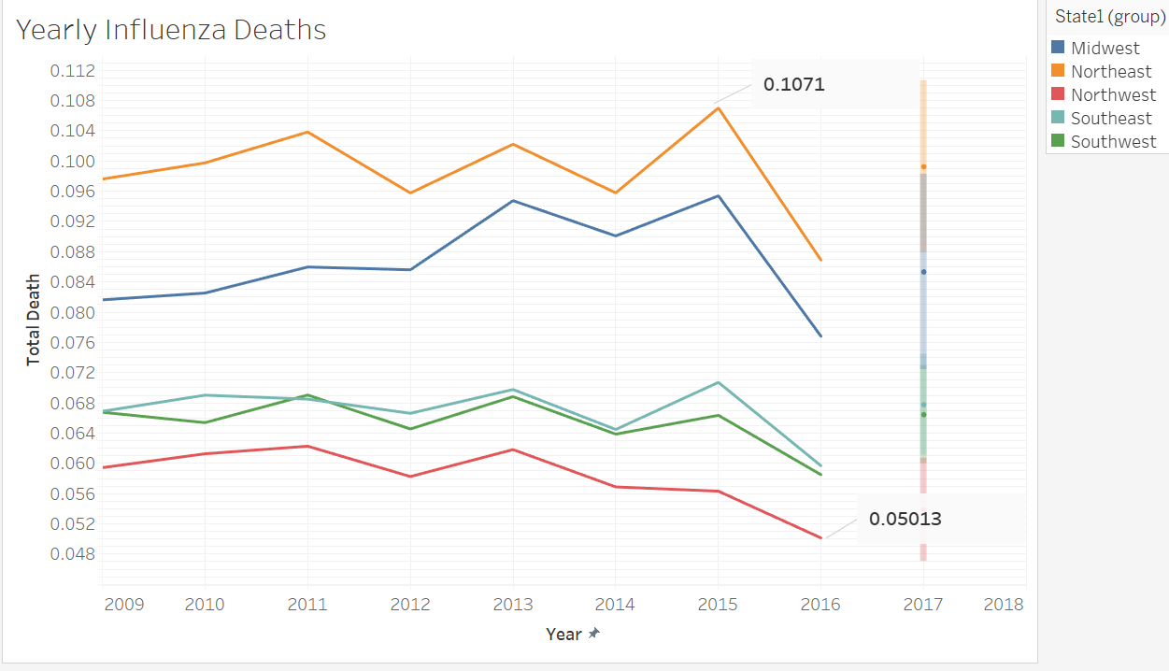
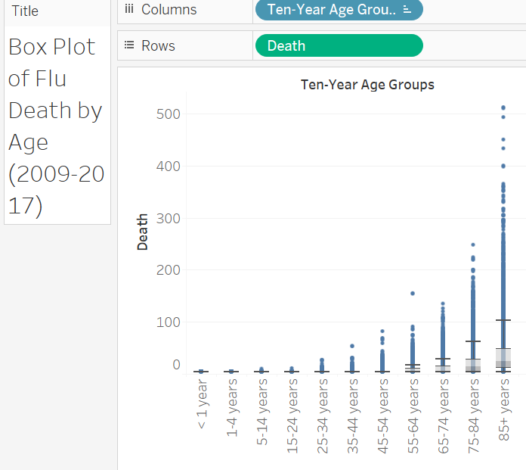
Regional and Age Analysis
I used Tableau to visualize the relationship between region and the average influenza death within the state and forecasting for future years.
Used Tableau to see what age group has the most deaths and would be the vulnerable group.

Slide 9
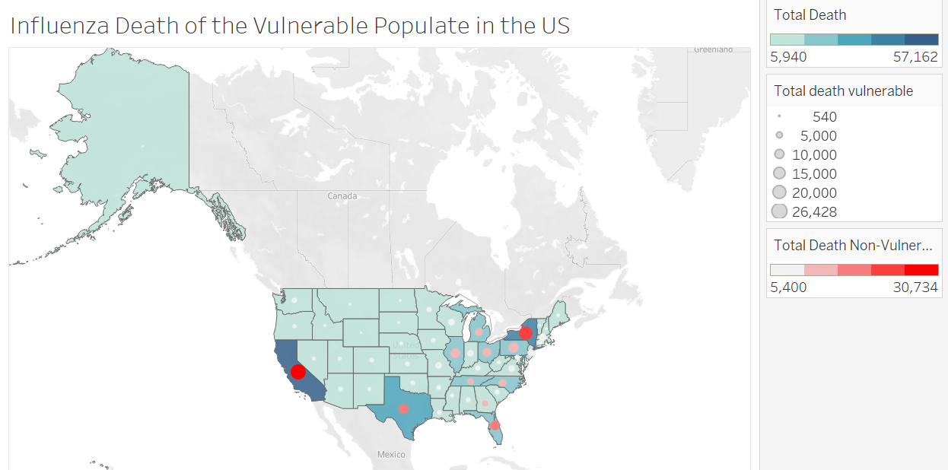
VULNERABLE STATE AND DEATH TOLLS
High vulnerability states such as New York have some of the highest death rates. However, large vulnerable populations do not directly relate to death rate as states with low vulnerable populations.
Vulnerability populations include people over the age 65, children under the age 5, and people with preexisting conditions

Slide 10
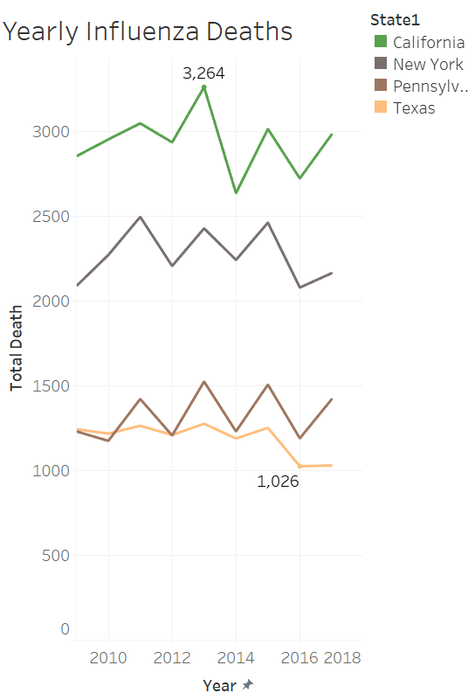
Risks and rewards
Results
Recommendations
When deciding what states will need the most staffing help during the peak influenza season looking at overall influenza rates and vulnerable death rates is going to be most helpful. Looking at the previous information we can see that California, New York, Pennsylvania, and Texas have the highest death rates and overall death due to influenza.
The recommendations would be to send the staffing to California, New York, Pennsylvania, and Texas as they are seeing the most death cases.
If we could get more in death data from the clinics, we may better be able to plain for the next influenza season.
Additional insights are needed from staff or locations, to analyses and plan on a deeper level
: Influenza Death of the Vulnerable Population in the US | Tableau Public

Slide 11
ROCKBUSTER STEALTH
Analyzing the database of Rockbuster Stealth, a fictional global movie rental company, to help develop the launch strategy for their new online video service by providing data driven answers to the Management Board.
Data
Data loaded into RDMS and queried using PostgresSQL Files included customer data, inventory data, and sales data Rockbuster Stealth Data
Tools
PostgresSQL
Tableau
Analytical Techniques
Relational Databases Database Querying Database Filtering Cleaning and Summarizing Joining Tables Subqueries and Common Table Expressions

Slide 12
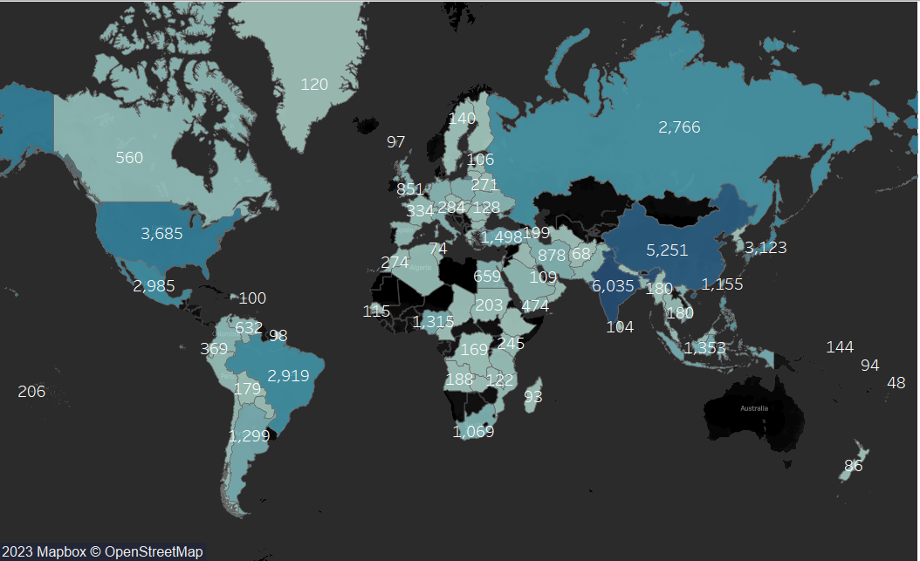
Data Analytics
Revenue by Country
Data cleaned, using CRUD method
Data was further manipulated using SQL commands to filter, group and summarized to determine key insights
Board was interested in which counties Rockbuster customers are based in and where the highest spending countries

Slide 13
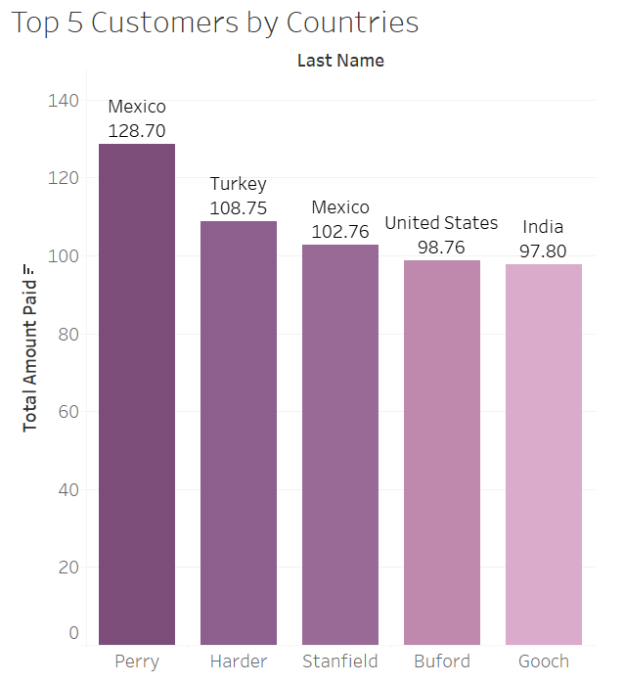
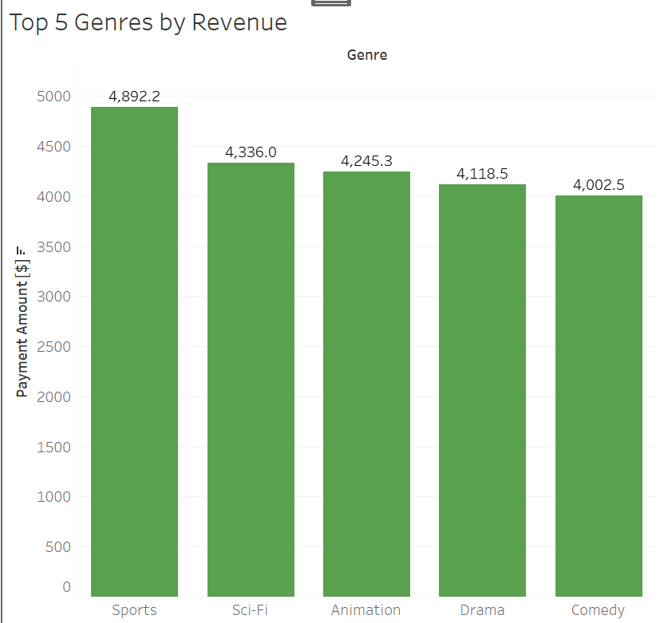
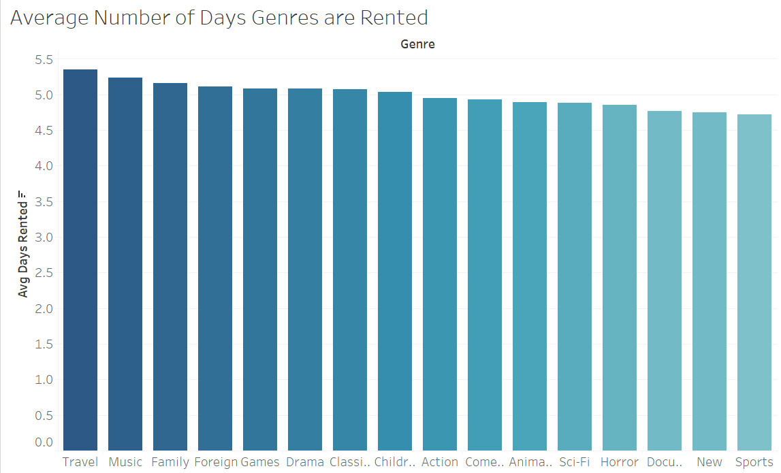
Data Insight
• Data was manipulated by applying:
• CTE – common table expressions • Subqueries
• JOINs
• Insights were extracted, and the aim was to determine where should Rockbuster focus its efforts and why
• Trends and correlations emerged based on performing the more advanced commands

Slide 14
Results and Recommendations
Results
Recommendations
Travel has the longest rental duration at almost 5.5 days
India: Has the most customers worldwide with 60 customers and revenue at $6,035
China: Has the second highest customers with 53 customers and revenue at $5,251
USA: Has the third highest customers with 36 customers and revenue at $3,685
jkmason90 (Jourdan M) (github.com)
Rockbuster Analysis | Tableau Public
https://d.docs.live.net/acfb05d6f4fa6932/Documents/3.10.xlsx
C:\Users\cmas9\Downloads\Data Dictionary.docx
C:\Users\cmas9\Downloads\Rockbuster-Stealth-3.10.pptx
With the analysis, we found out that the genre Travel has the longest rental duration. This means people like to watch these movies for a longer time span. It would be recommended to do more advertising with this genre and expanding home many movies in the Travel genre that are available to customers.
The analysis showed the India, China, and the United States had the highest number of customers and the highest revenue. More funds should be allocated to these countries for advertising as they have the biggest revenue and number of customers.
Having a reward system in place for the top 5 customers worldwide. If it is quarterly or yearly to give them a little something extra for being so loyal to the company. This may start a competition with the customers.

Slide 15

Instacart
Instacart is an open-source data set, that contains information about customers and their purchase habits. The goal is to analyze purchasing habits of different socio-economic groups of customers and advise marketing strategy.
Data
Fictional customer base
https://d.docs.live.net/acfb05d6f4fa6932/Documents/Master%20folder/Project%20Management/Data
Tools
Python 3
Jupyter Notebook Pandas
NumPy
Seaborn
and Matplotlib libraries
Analytical Techniques
Data Wrangling and Cleaning with Python Data merging Deriving variables
Grouping and aggregating data Manipulating data frames Data visualization with matplotlib and Seabor

Slide 16
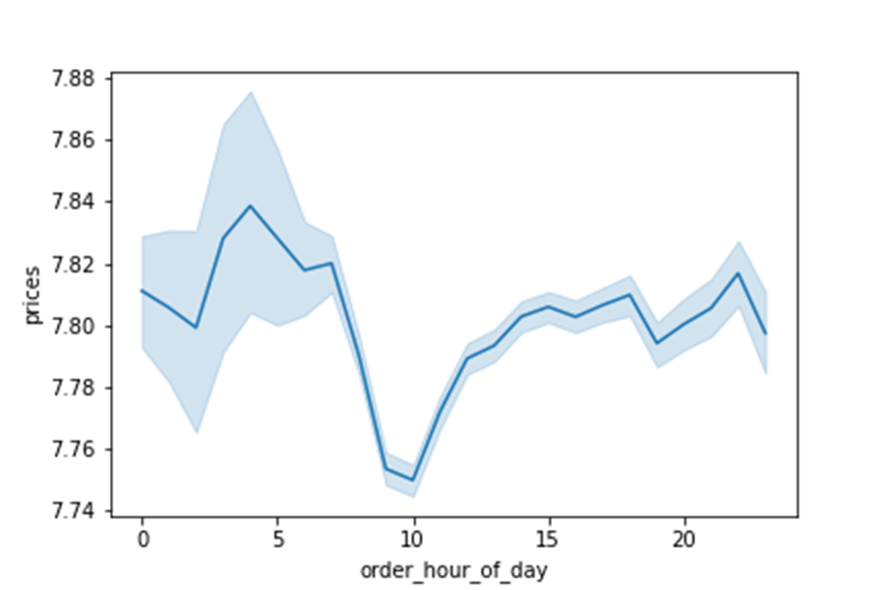
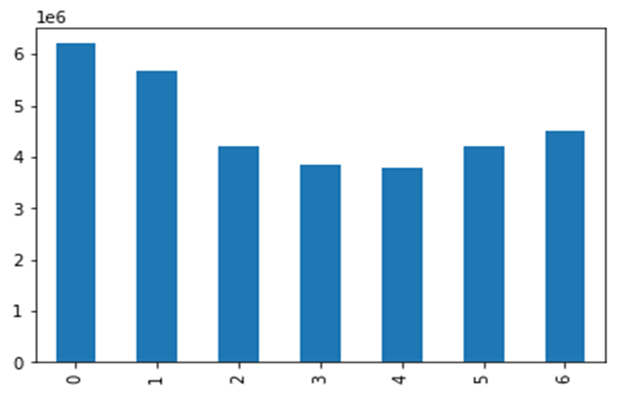
EXPLORATORY DATA ANALYSIS
Price per Hour
Exploring basic patterns such as busiest days, days with most orders or busiest hours of the day
Used Python commands to wrangle and clean data
Connected data sets
Performed commands to group, aggregate and summarize
Derived insights and used Python to create visualizations
0= Saturday
1= Sunday
2= Monday
3= Tuesday
4= Wednesday
5= Thursday
6= Friday

Slide 17
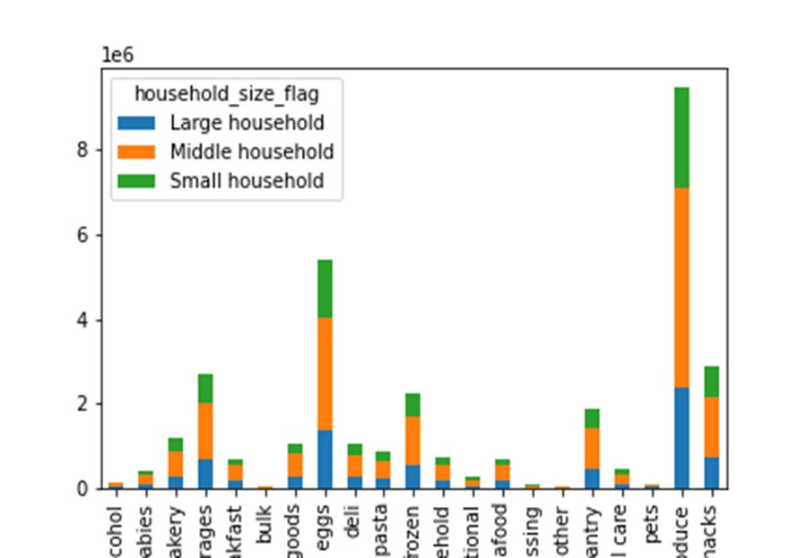
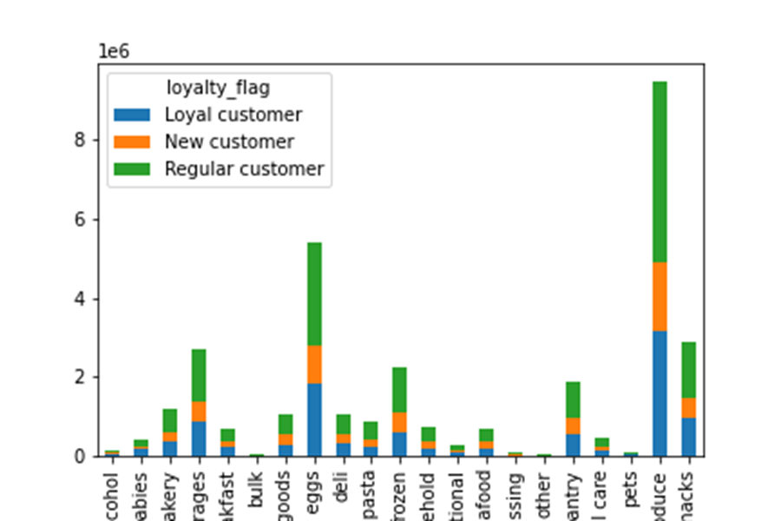
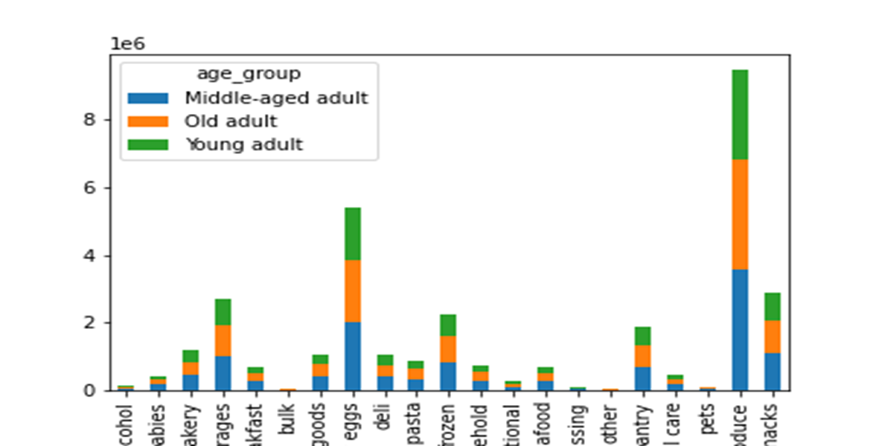
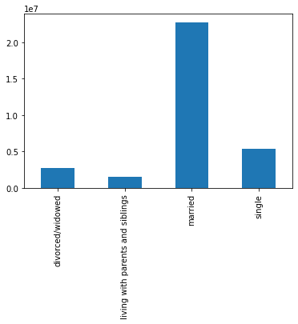
CUSTOMER PROFILING
Orders by Goods and Family Status
Customer Loyalty to Frequency of Orders
Customer profiles were divided by age, loyalty, family size, and marital status.
They were further grouped and grouped by regions
This provided insights into customer’s spending habits based on different socioeconomic backgrounds
Marital Status with Frequency of Orders
Orders by Department and Age

Slide 18
Results and Recommendations
Results
Recommendations
What we can see is that the regular customers mostly consist of the middle-aged people who are buying lower priced items more frequently. They are order produce, milk eggs, snacks, beverages, and frozen items most often. We can also see a large number of our regular customers live in the Southern states.
https://d.docs.live.net/acfb05d6f4fa6932/Documents/Master%20folder/Project%20Management/Project%20Management.zip
jkmason90/Instacart (github.com)
What we can do to increase other regions to have a higher regular customer population is to advertise more. For example, the West is close behind with regular customer numbers, then Midwest, and Northeastern regions.
Reflect and see if advertising is higher in the Southern regions than the Northeast. Advertising more or if it is a delivery issue, promote to delivers more.
To try to increase the Regular customer number we can take the Loyal customers and give them incentives to become Regular customers. Incentives could be anything from a rewards program where they purchase a certain dollar amount in a month, and they get a certain dollar amount off their next order.

Slide 19


Seattle, WA Housing Prices
Analyzing data for the sales of houses in Seattle, WA. The data had variables that could aid in the increase of the sales price of the house. I used Python to determine what variables had a strong correlation with the price of the house.
Analytical Techniques
Big data
Data ethics
Data mining
Predictive analysis
Time series analysis and forecasting
Using GitHub
Data:
Downloaded from Kaggle
House Sales in King County, USA | Kaggle
Tools:
Excel
Python
Tableau
GitHub
jkmason90/Seattle-WA-Housing-Market (github.com)
Seattle, WA House Sales | Tableau Public

Slide 20
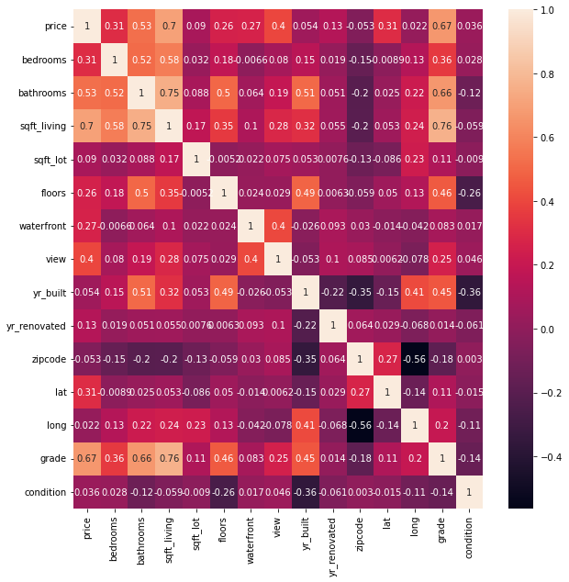
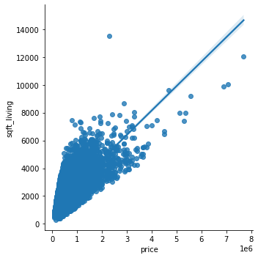
EXPLORATORY DATA ANALYSIS
Correlation Heatmap
Performed an exploratory analysis through visualizations including scatterplots, correlation heatmaps, pair plots, and categorical plots in order to identify different relationships and develop a hypothesis. Further investigation was administered utilizing regression analysis , cluster analysis , and time - series analysis.
Scatterplot

Slide 21
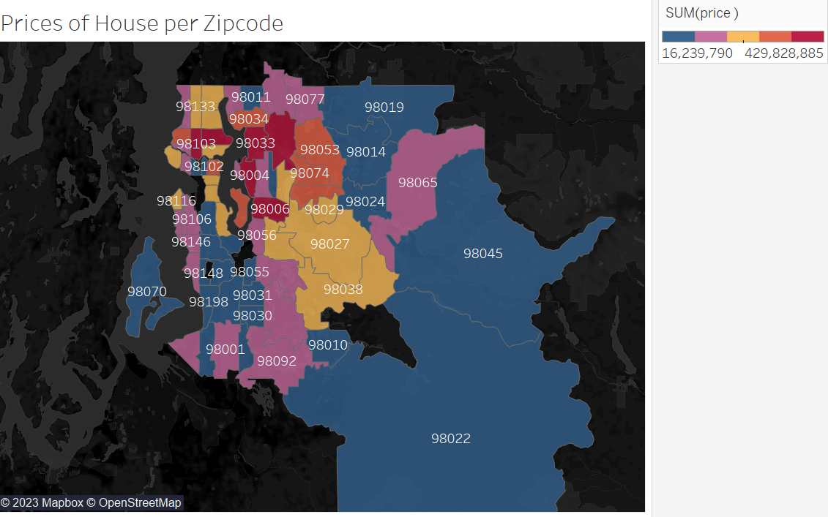
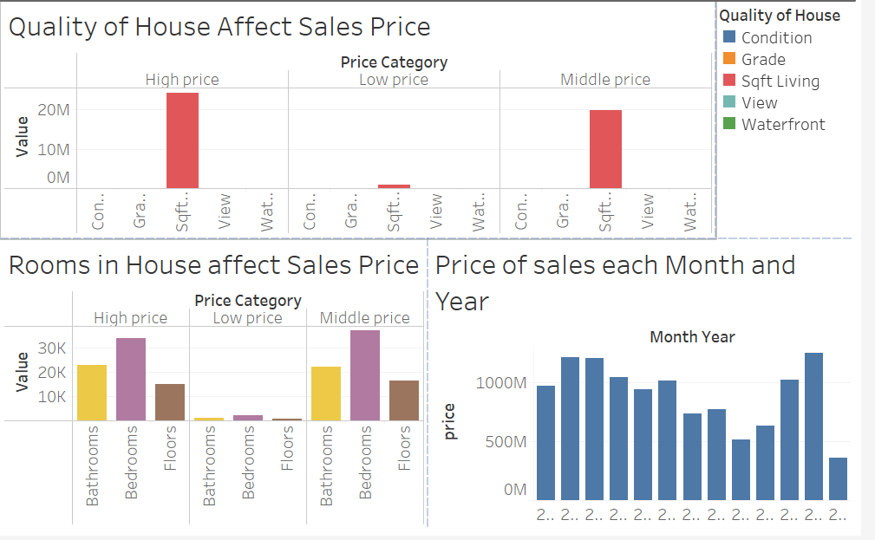
Visualizations
Utilized Tableau to continue to draw in sights using data visualization techniques. Manipulated data to create captivating composition and comparison charts, and statistical visualizations. A color-coded map was used to see what houses cost in different zip codes. In doing so we found out the closer to city center the higher the price. Bar charts were used to see what variable has the strongest correlation with the price of the home. Finally, to see if there is a seasonality to what time of month year houses sell at higher prices. Insights and visualizations were organized, highlighted, and published on Tableau.

Slide 22
Results and Recommendations
Results
Recommendations
The variable that had the strongest correlation with the sale price of the home was square foot living space. Other variables were weak correlations.
The closer to city center the more the price increase for the homes.
Additional data that could be collected is the age groups that are buy the homes in the different zip codes. This way real estate agents could market the homes to the group that is most likely going to buy the homes.
If the city is wanting to more information, you could take a survey with the people who live closest to city center and see why they rather live there than farther from city center.
Depending on survey for reason you could add those items around the other zip codes. Example would be restaurants, shops, or things to do.

Slide 23
Thank you
Jourdan Mason
989-***-****
email@yahoo.com
jkmason90 (Jourdan M) (github.com)
Profile - jourdan3012 | Tableau Public

